Slide 1
Reinforcement Learning
Session 4
openAI gym
.
( Disclaimer: content has been taken from various authors and websites)
Notes:
3/28/2019
1

Slide 2
Todays Agenda
Recap
Q-Learning
DNQ
Programs
Questions.

Slide 3


Slide 4
RECAP

Slide 5
What is RL ?
In Reinforcement Learning, an agent learns by interacting directly with its environment and recording the reward it gets along the way.
The goal of an RL agent is simply to identify those actions that will lead to the maximum, cumulative future reward.
The agent learns directly from its environment, it doesn’t require huge amounts of pre-existing, domain-specific, training data. It generates its own training data simply by interacting with its environment and learning from its experience.
Key Aspects of RL
Agent Is not told, what to do.
Trial and Error Search.
Delayed Rewards.
Explore v/s Exploit.

Slide 6

Components of RL
Environment: An environment is like a mini-world where an agent can observe discrete states, take actions and observe rewards by taking those actions.
Agent:
Action: In each state, the agent is presented with a number of possible choices. The goal of the agent is to learn the best action to take in its current state.
State: Numeric representation of what the agent is observing at a particular point of time in the Environment.
Reward: a feedback signal from the Environment reflecting how well the agent is performing.

Slide 7
Components of RL
Value : Future reward that an agent would receive by taking an action in a particular state.
Model: Its an Agent representation of the Environment.
Policy: A policy, is like a blueprint, telling the agent which action to take when they find themselves in a given state.
The purpose of RL is to learn the optimal policy, and RL algorithms provide the blueprint to tell the agent how to find it.

Slide 8
What is a Policy?
A policy is a solution to the Markov Decision Process.
A policy is a set of actions that are taken by the agent to reach a goal.
It indicates the action ‘a’ to be taken while in state S.
A policy is denoted as ‘Pi’ π(s) –> ∞

Slide 9
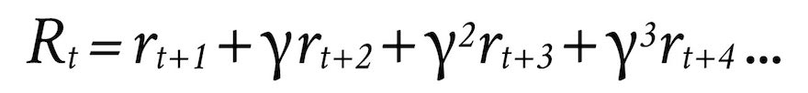
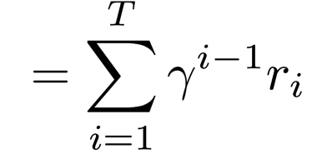
Discount Rate (γ)
Value of a reward in the future is less than the value of a reward right now. The discount rate is between 0 and 1, and determines how much less a reward earned in the future is worth, compared to now.
Using a Discount Rate, prevents the Total Reward from going to infinity.
It models the agent behavior, does the agent prefers immediate rewards, rather than potential rewards in the future.
Total Discounted Reward Rt is

Slide 10
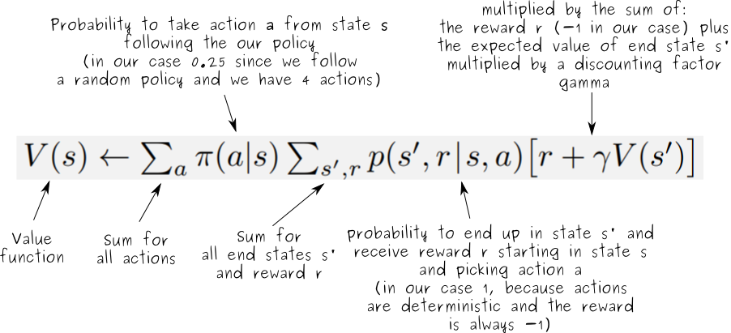
State-Value Function ‘V(s)’
The state value function describes the value of a state when following a policy.
It is the expected return when starting from state acting according to our policy :
We can represent V mathematically as follows:

Slide 11
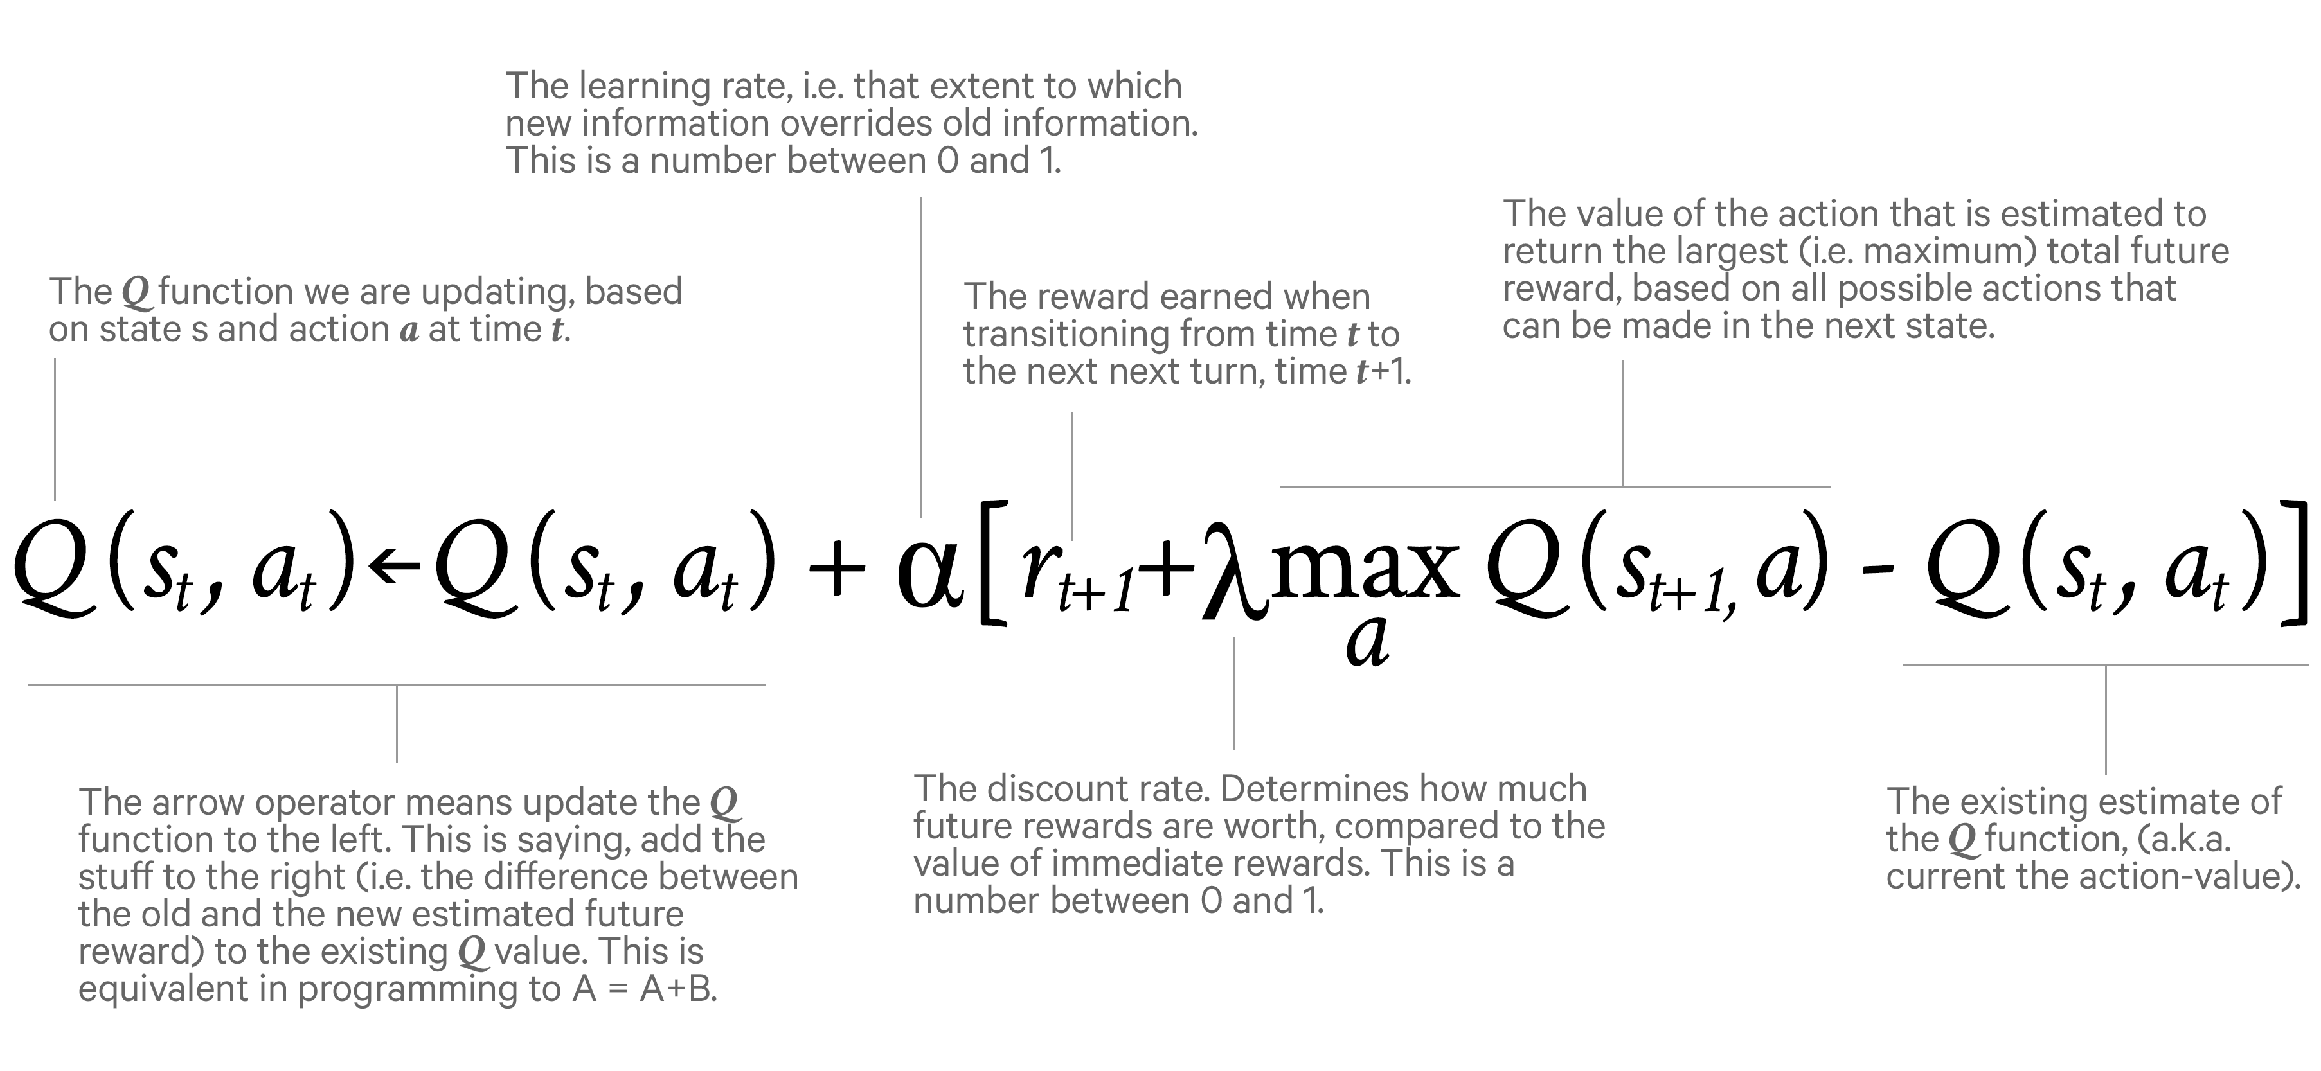
Action-Value Function: Q(s,a)
.The action value function tells us the value of taking an action in some state when following a certain policy.

Slide 12
The state-value and action-value functions are the critical parts of RL.
These functions quantify how much each state or action is estimated to be worth in terms of its anticipated, cumulative, future reward.
Choosing an action that leads the agent to a state with a high state-value is tantamount to making a decision that maximizes long-term reward.

Slide 13
The challenge is, figuring out V and Q
One challenge faced when calculating V and Q is that the value of a given state A’, is dependent on the value of other states, and the values of these other states are in turn dependent on the value of state A.
This results in a classic chicken-or-the-egg problem:
The value of state A depends on the value of state B, but the value of state B depends on the value of state A.
‘

Slide 14
In a stochastic system, when we don’t know the underlying probabilities, the reward that an agent receives when following a given policy may differ each time the agent follows it, just through natural randomness.
In order to maximize the policy based on the most likely outcomes, we need to learn the underlying probability distributions, which we do through repeated observation.
(This problem, called the “N-Armed Bandit,” can be represented as a single state MDP, with the pull of each slot machine representing a different action.)

Slide 15
The above challenges can be addressed by calculating state-values iteratively.
We run our agent through the environment many times, calculating state-values along the way, with the goal of improving the accuracy of the V and/or Q each time.
The agent is first provided with an initial policy(random actions or based on an existing policy )
The agent follows this policy over and over, recording the state-values (and/or action-values) with each iteration.
With each iteration, the estimated state-values (and/or action-values) become more and more accurate, converging toward the optimal state-value (V*) or the optimal action-value (Q*).
Updating estimated state-values this way is called “prediction” because it helps us estimate or predict future reward.

Slide 16
Prediction helps, refine the estimates of future reward with respect to a single policy, it doesn’t necessarily help us find better policies.
The process of iteratively improving policies is called “control” (i.e., it helps us improve how the agent behaves).

Slide 17
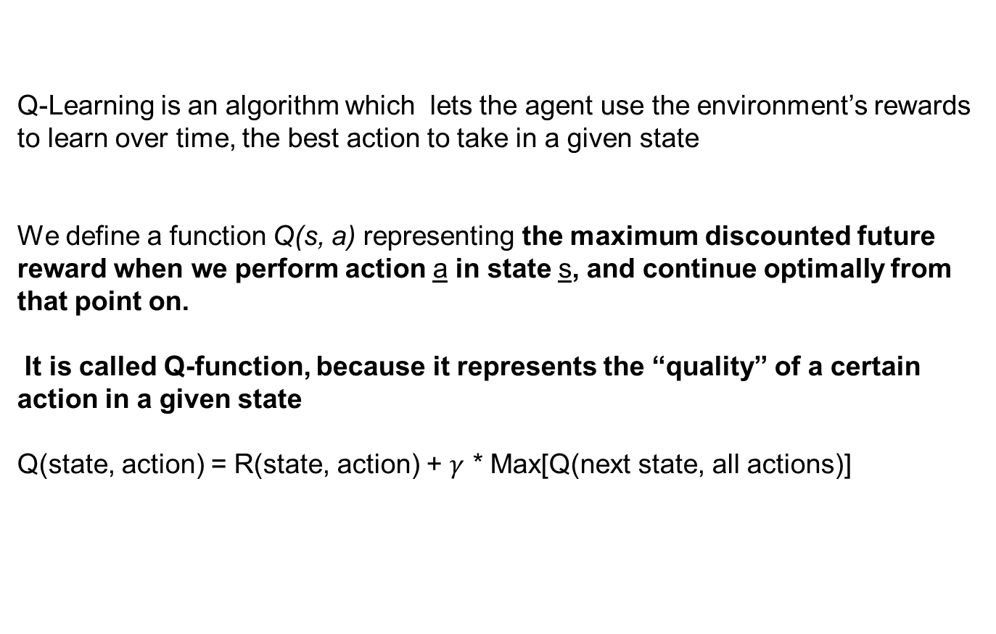
Q-Learning
Q-Learning is an algorithm which lets the agent use the environment’s rewards to learn over time, the best action to take in a given state
We define a function Q(s, a) representing the maximum discounted future reward when we perform action a in state s, and continue optimally from that point on.
It is called Q-function, because it represents the “quality” of a certain action in a given state
Q(state, action) = R(state, action) + $γ$ * Max[Q(next state, all actions)]

Slide 18
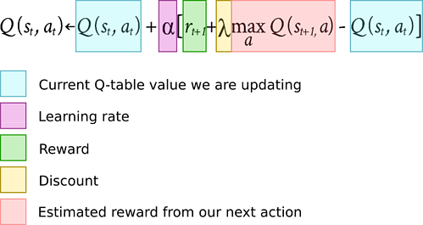
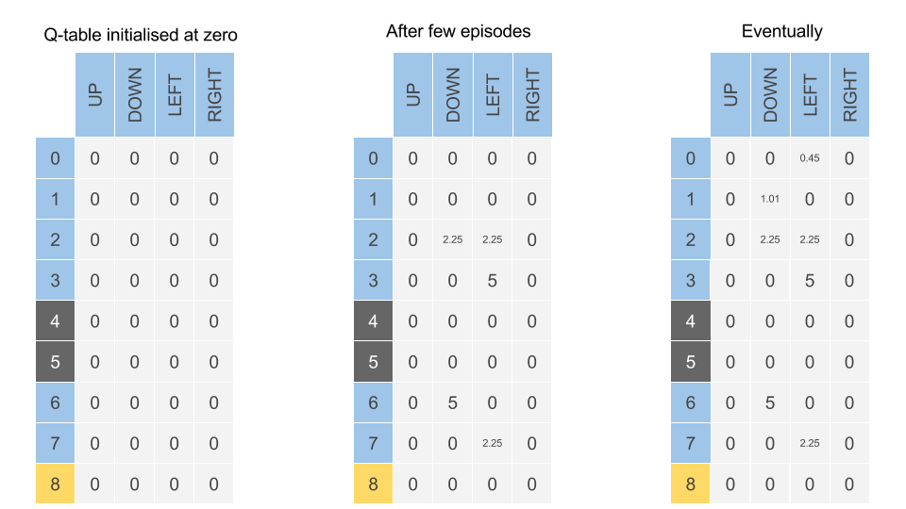
Q-Learning
The main idea in Q-learning is that we can iteratively approximate the Q-function using the Bellman equation.
In the simplest case the Q-function is implemented as a table, with states as rows and actions as columns.

Slide 19
Q-Learning
The values stored in a Q-Table are called Q-Values. And they map to a (state, action) combination.
A Q-value for a particular state-action combination is representative of the quality of an action taken from that state.
Better Q-values , means better chances of getting greater rewards.
Q-values are initialized to 0/ arbitary values, and as the agent exposes itself to the environment and receives different rewards by executing different actions, the Q-Values are updated using the equation
Q(s,a) = (1 — α) * Q(s, a) + α *(r + ɣ* maxaQ(s’, a’))

Slide 20
Q-Learning
Expressed as:
Q(s,a) = (1 — α) * Q(s, a) + α *(r + ɣ* maxaQ(s’, a’))
where:
α learning rate
ɣ discount rate
Q value of the agent current state and action = Weight (1- α ) * Old Q Value
Then adding the Learned Value
Learned Value is a combination of Reward for the taking the Current Action in the current State, and the discounted max reward from the next state we will be once we take the current action.

Slide 21
Q- Learning
How well this algorithm works depends on the choice of exploration strategy used to interact with the environment — if you never visit a particular state of the environment or take a particular action in that state, then you are never going to know the consequences of taking that action in that state.
Nevertheless, we don’t just want to randomly move through our environment either.
Ideally, once we have collected some information about our environment, we would like to exploit this information by focusing our future exploration on the states and actions that we believe are likely to result in the greatest reward.
One way of doing this is using the epsilon greedy strategy.

Slide 22
Q- Learning
The main challenge with Q-Learning and the Bellman Equation comes to the compute cost associated with estimating all combinations of state-action rewards.
The computation cost quickly gets out of control in problems involving a decent number of states.
To deal with that challenge, there are techniques that try to approximate a Q-function instead of learning an exact one by evaluating all possible Q-Values.
One of the biggest breakthroughs in Q-Learning came from DeepMind when they used deep neural networks to estimate the Q-Value of all possible actions for a given state. This technique is called Deep-Q-Networks.

Slide 23
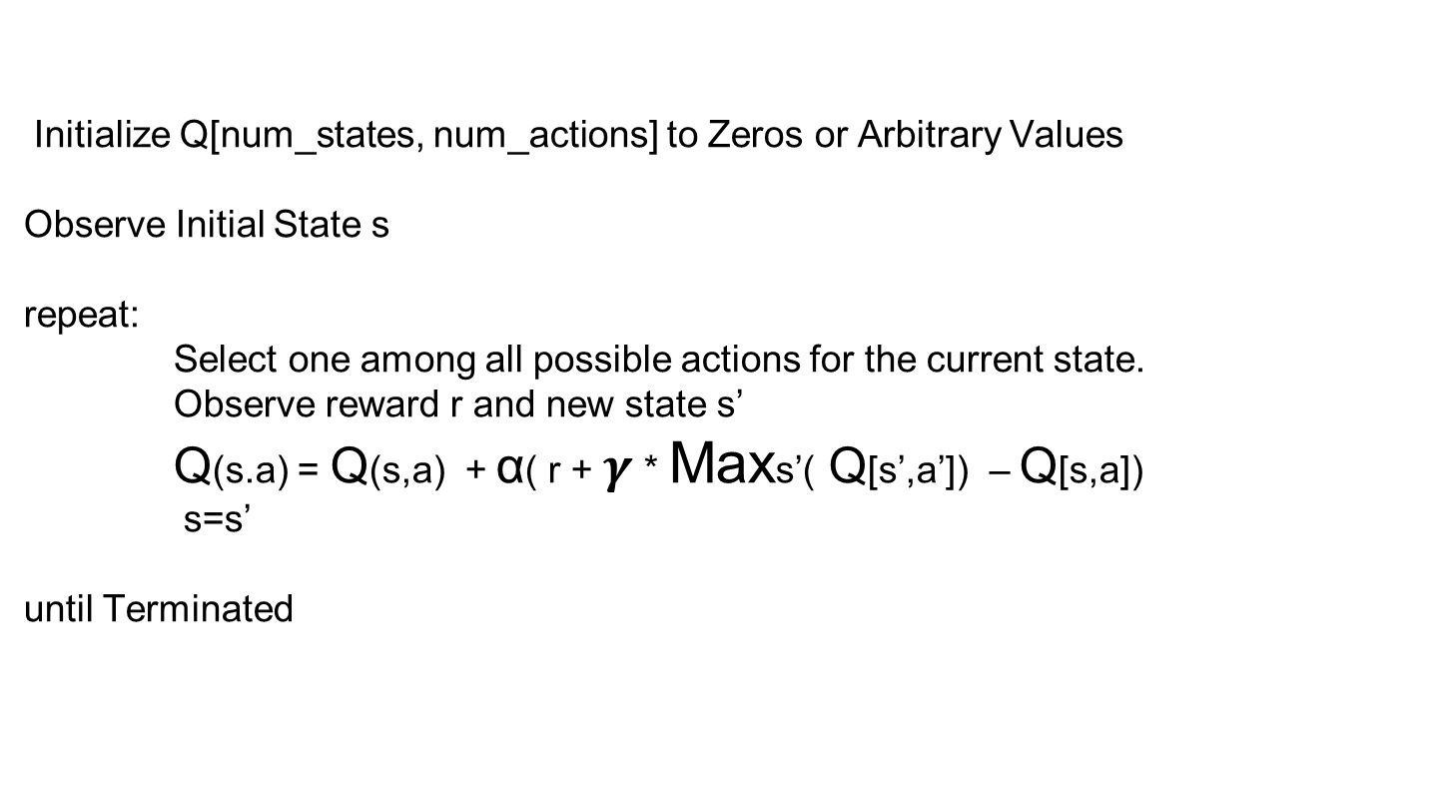
Q-Learning pseudocode
Initialize Q[num_states, num_actions] to Zeros or Arbitrary Values
Observe Initial State s
repeat:
Select one among all possible actions for the current state.
Observe reward r and new state s’
Q(s.a) = Q(s,a) + α( r + $γ$ * Maxs’( Q[s’,a’]) – Q[s,a])
s=s’
until Terminated

Slide 24
α : Learning rate that controls how much of the difference between previous Q-value and newly proposed Q-value is taken into account.
Note: when α =1, then two Q[s,a] cancel and the update is exactly the same as the Bellman equation.
The max_{a’} Q[s’,a’] that we use to update Q[s,a] is only an approximation and in early stages of learning it may be completely wrong. However the approximation get more and more accurate with every iteration and if we perform this update enough times, then the Q-function will converge and represent the true Q-value

Slide 25
Jupyter Notebooks
Mcar_QTable_GYM
Mcar_DQN_tfgpu_gym_keras
Other Programs for your
Maze_qlearn_base.ipynb
Maze_tfalpha.ipynb
qLearn.ipynb
Pybulletsample_base.ipynb

Slide 26
MountainCar-v0
Observations
Type: Box(2)
Actions:
Type: Discrete(3)
Num | Observation | Min | Max
0 | Position | -1.2 | 0.6
1 | Velocity | -0..07 | 0.07
Num | Action
0 | Push Left
1 | No Push
2 | Push Right

Slide 27
MountainCar-v0 (cont’d)
Reward
Starting State
Num | Observation
-1 | For each Time Step, until goal position of 0.5 reached
 | Value
Position | -0.6 to -0.4
Velocity | 0

Slide 28
MountainCar-v0 (cont’d)
Episode
Termination
Reach goal position 0.5
200 iterations Reached

Slide 29
Next Session

Slide 30
Extra Reading Material

Slide 31
Comparison of reinforcement learning algorithms
Algorithm | Description | Model | Policy | Action Space | State Space | Operator
Monte Carlo | Every visit to Monte Carlo | Model-Free | Off-policy | Discrete | Discrete | Sample-means
Q-learning | State–action–reward–state | Model-Free | Off-policy | Discrete | Discrete | Q-value
SARSA | State–action–reward–state–action | Model-Free | On-policy | Discrete | Discrete | Q-value
Q-learning - Lambda | State–action–reward–state with eligibility traces | Model-Free | Off-policy | Discrete | Discrete | Q-value
SARSA - Lambda | State–action–reward–state–action with eligibility traces | Model-Free | On-policy | Discrete | Discrete | Q-value
DQN | Deep Q Network | Model-Free | Off-policy | Discrete | Continuous | Q-value
DDPG | Deep Deterministic Policy Gradient | Model-Free | Off-policy | Continuous | Continuous | Q-value
A3C | Asynchronous Advantage Actor-Critic Algorithm | Model-Free | Off-policy | Continuous | Continuous | Q-value
NAF | Q-Learning with Normalized Advantage Functions | Model-Free | Off-policy | Continuous | Continuous | Advantage
TRPO | Trust Region Policy Optimization | Model-Free | On-policy | Continuous | Continuous | Advantage
PPO | Proximal Policy Optimization | Model-Free | On-policy | Continuous | Continuous | Advantage

Slide 32
Contact Details
Email: aliasgertalib@gmail.com
Linkedin: https://www.linkedin.com/in/aliasgertalib
GitHub
https://github.com/aliasgertalib-AI

Slide 33
References
OpenAI Gym
RL Terminology
https://spinningup.openai.com/en/latest/index.html
https://towardsdatascience.com/reinforcement-learning-rl-101-with-python-e1aa0d37d43b
https://medium.com/applied-data-science/alphago-zero-explained-in-one-diagram-365f5abf67e0
https://applied-data.science/static/main/res/alpha_go_zero_cheat_sheet.png

